Slide 1






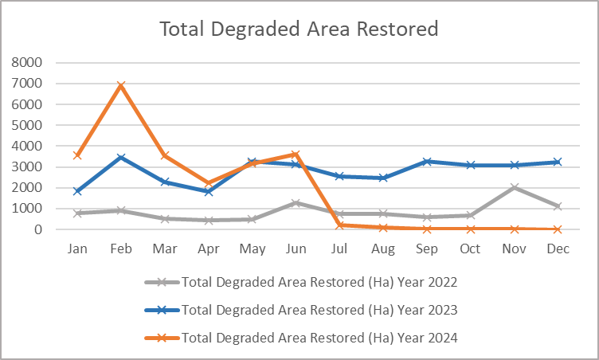



FORESTRY
MUDeNR Outcome:
1. Increase Timber & Non Wood Forest Products Exports Earnings
2. Community-Based Ecotourism and conservation Totally Protected Area
3. Certify Long Term Forest License Area and Forest Plantation
4. 200,000 ha degraded area (100%) planted/restored by 2030
5. Obtain world recognition for sustainable management practices and conservation effort
1st Half Yearly 2025
RM 8 bil in exports by 2030
Project/Programme
1st Half Yearly 2025 Target
Rating
1st Half Yearly 2025 Status
Generate government
revenue by developing new
revenue streams from forest
resources
Implementation of Forest Landscape Restoration Throughout Sarawak
Conservation & Protection
of Wetlands & Watershed Within Heart of Borneo Sarawak (HoB)
TOTAL 2024 = RM2,836,744,000.0
Strategy 1
TOTAL 2025 (Jan – Jun) =-
Quantifying Forest Carbon Stock In Sarawak
.
To plant 1,000 ha of bamboo cumulative
To produce 350,000 seedlings cumulative
Proposed nursery plan and site identification
Manpower and implementation planning
TPA Protection & Biodiversity Conservation Programs (incl. community-based initiatives
-
On-going programs and initiatives by SFC (as of December 2024)
Bamboo Industry Development
Gain higher export earnings
through the advancement in
downstream processing
-%
-%
Strategy 2
Certification of FMU & FPMU
Furniture Park
RMK-13 application for Demak Laut Furniture Park (Project brief submission)
Monitor progress of the RMK-13 submission for Demak Laut Furniture Park
Investment Promotion
•Revised SDEC paper to seek approval for funding to develop the proposed Demak Laut Furniture Park in RMK-12 project submitted on 11 March 2025.
Promoted site for Tanjung Manis Furniture Park during STIDC Industry Update on 15 April 2025
2,179,854 ha FMU Certified (as of December 2024)
122,800 ha FPMU Certified
(as of December 2024)
Sarawak Delta Geopark (SDGp)
UNESCO Global Geopark
TOTAL 2025 = ha
Gain national and
international recognition
through conservation and
sustainable management
Strengthening protection for selected Totally Protected Areas (TPA)
Development and upgrading of integrated facilities of 20 TPA
Strategy 3
Strengthening Forest Enforcement
Half Yearly Report
Obtain world recognition for sustainable management practices and conservation effort
-%
-%
Lambir Hill NP and Bako NP inscribed as ASEAN Heritage Park
Submission of AHP Nomination Document
Preparations for site evaluation
Site Evaluation by ACB
Endorsement as AHP
SDGP UNESCO
Global Geopark
(as of Jun 2025)
Lambir Hill NP and Bako NP inscribed as ASEAN Heritage Park(as of Jun 2025)
Monthly target achieved, Project on track
Miss in target but
still on track for 2025
Severe delays
Not started
DRAFT 2025
Legend:
2024
2025

